Slide 1

Introduction to Data Science/Machine Learning
University of Wisconsin Milwaukee
Fall 2025
Sammie Omranian

Slide 2

Girls Who Code – Week 9
Building Our First Machine Learning Model

Slide 3
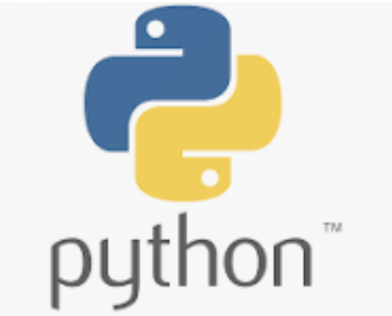
Welcome Back!
Let’s continue our journey — today the computer will learn from data!
Today’s Plan:
Review: AI, ML, Train/Test
Train our first model
See how predictions work
Hands-on – practice
Reflection
🕒 We’ll learn → code → see results → share discoveries!

Slide 4
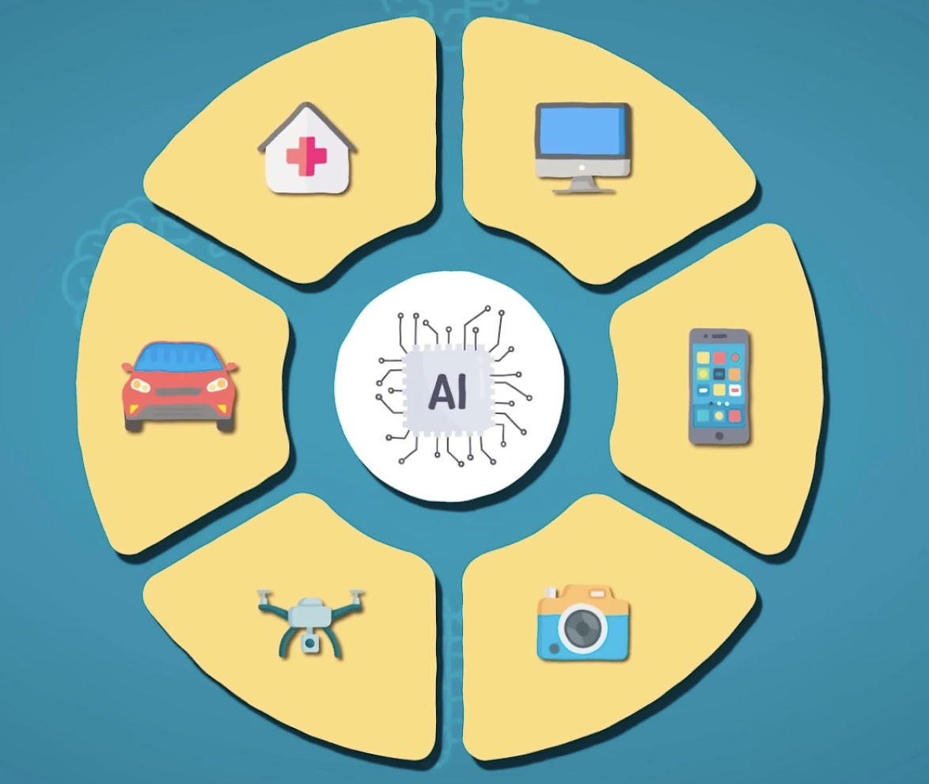
Quick Recap – What is AI?
AI means making computers think and learn like humans — to recognize, decide, and improve with experience.
AI isn’t just robots — it’s behind apps we use every day.
Siri, ChatGPT, Netflix, and Snapchat filters all use AI in different ways.
AI = “teaching computers to be smart.”
Image credit

Slide 5
Examples of AI in Everyday Life
🎶 Spotify: learns your taste to recommend songs
🗺️ Google Maps: finds the fastest route
📱 TikTok: learns what you watch
🩺 Healthcare AI: detects early signs of illness

Slide 6
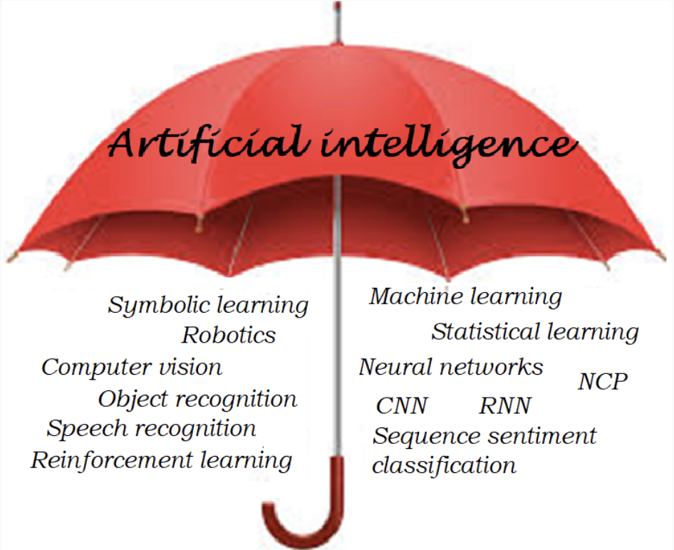

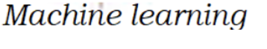
What is Machine Learning (ML)?
Machine Learning (ML) is a part of AI that learns from data instead of being programmed with rules.

Slide 7
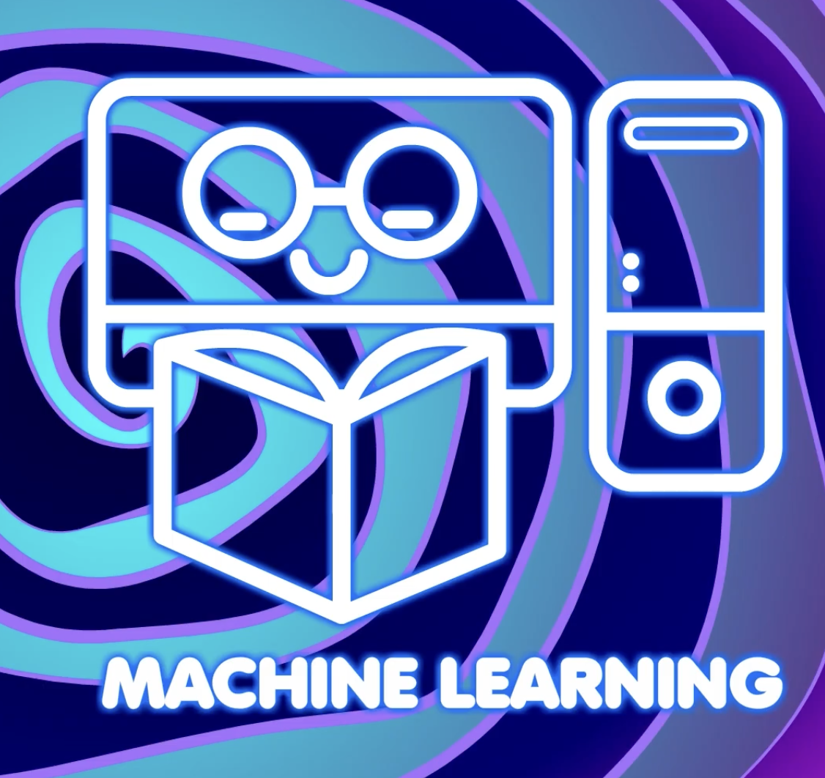
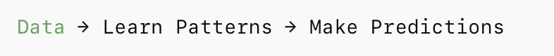
How Machine learns?
Computers learn by finding patterns in data.
We can use those patterns to make predictions.
That’s what we’ll do today!

Slide 8
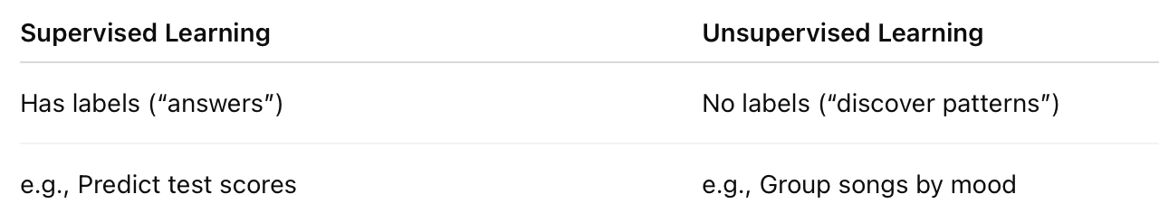
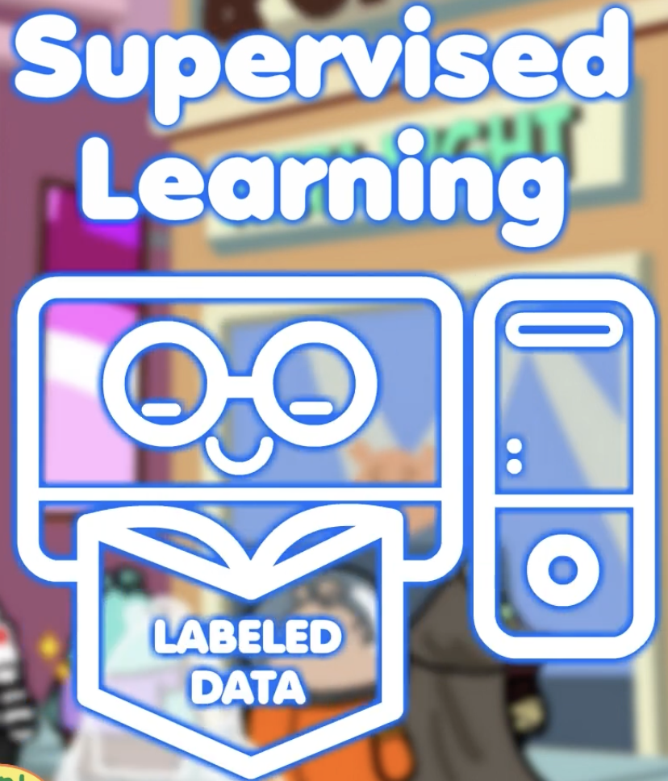
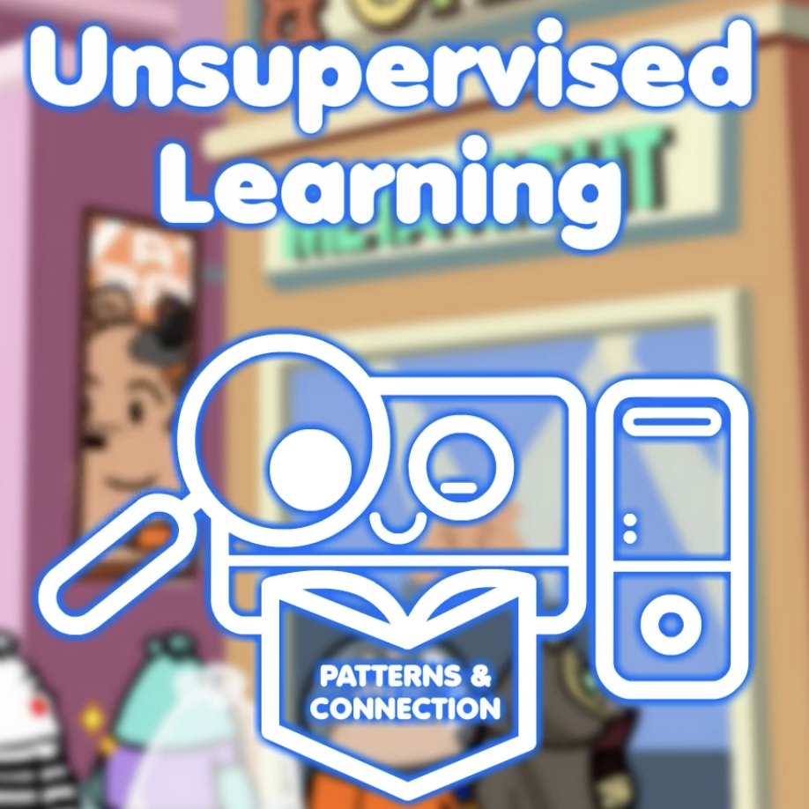
Types of Machine Learning

Slide 9
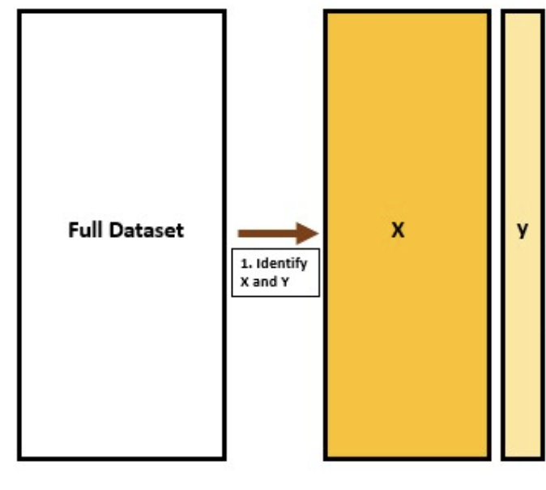
Supervised Learning – We have X and Y
Features
Labels

Slide 10
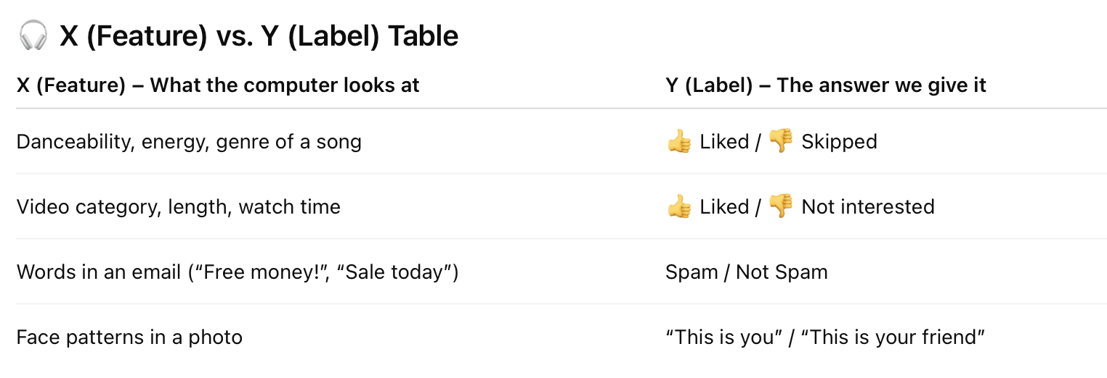
Supervised Learning – We have X and Y

Slide 11
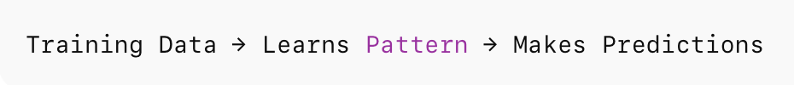
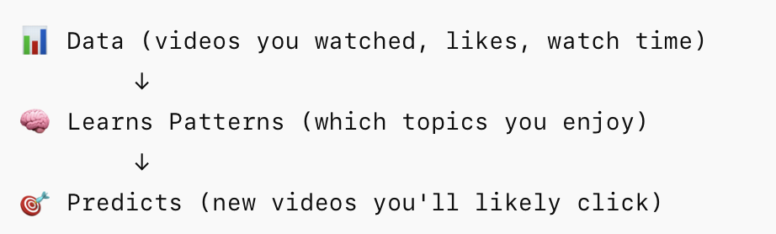
How the Computers Learn?
Example:
YouTube
YouTube learns by watching your behavior — what videos you click, how long you watch, and what you skip.
It uses those examples (data) to learn patterns and then predict what you’ll want next.

Slide 12
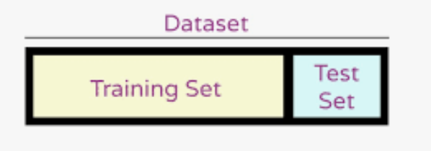
Splitting Data - Train and Test Data
80%
20%
Most of the data helps the computer learn.
A small portion is kept aside to evaluate performance.
In Python, we’ll use a built-in function to do this automatically.

Slide 13
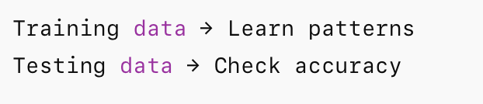
What Happens After Splitting Data?

Slide 14
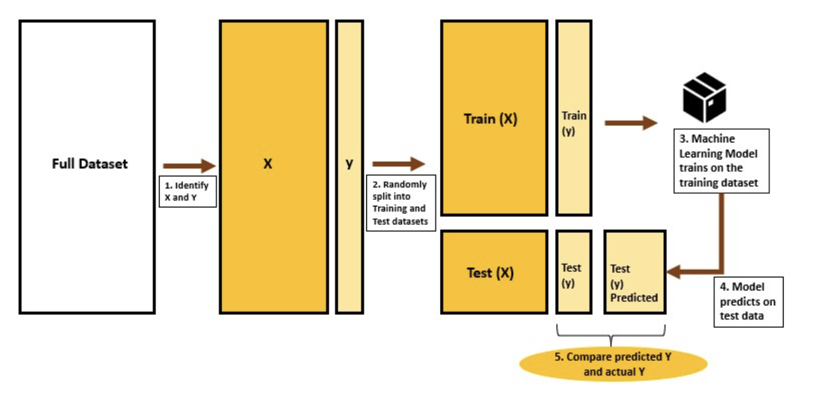
What Happens After Splitting Data?

Slide 15
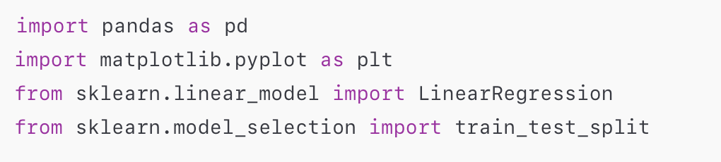

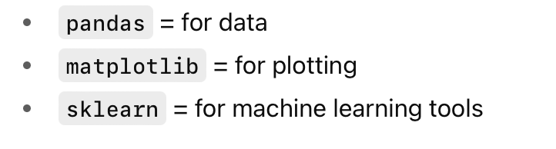
Hands-On Practice – Let’s Code
Step 1: Import Libraries and Data
🧩 Try in Python:
What are these libraries?

Slide 16
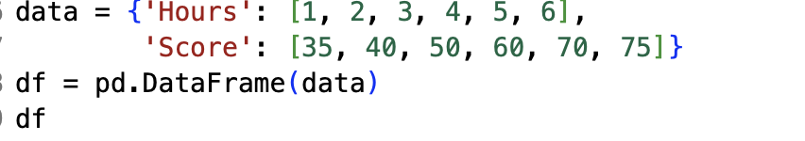
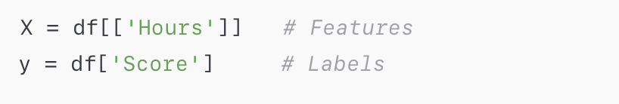
Hands-On Practice – Let’s Code
Features and labels – X and Y
🧩 Try in Python:

Slide 17
Hands-On Practice – Let’s Code
✂️ Step 2: Split Data into Train/Test Sets
We divide our data into two groups:
Training data (80%) → the computer learns from this.
Testing data (20%) → we check if it really learned.
test_size=0.2 means 20% for testing and 80% for training.
random_state=42 just makes sure we get the same random split each time we run it.
🧩 Try in Python:

Slide 18
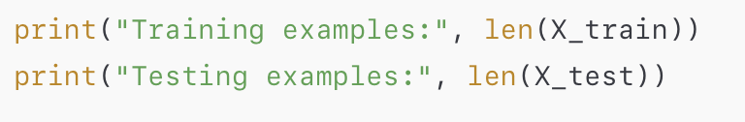
Hands-On Practice – Let’s Code
✂️ Step 2: Split Data into Train/Test Sets
We “train” the model on most of the data.
We “test” on a smaller part to see how it performs on new data.
Here, 80% train / 20% test.
It is like: Studying with Flashcards! (train = study cards, test = quiz cards).
🧩 Try in Python:

Slide 19

Google Colab – Our Coding Hub Where we’ll write, run, and share all our Python code

